Slide 1
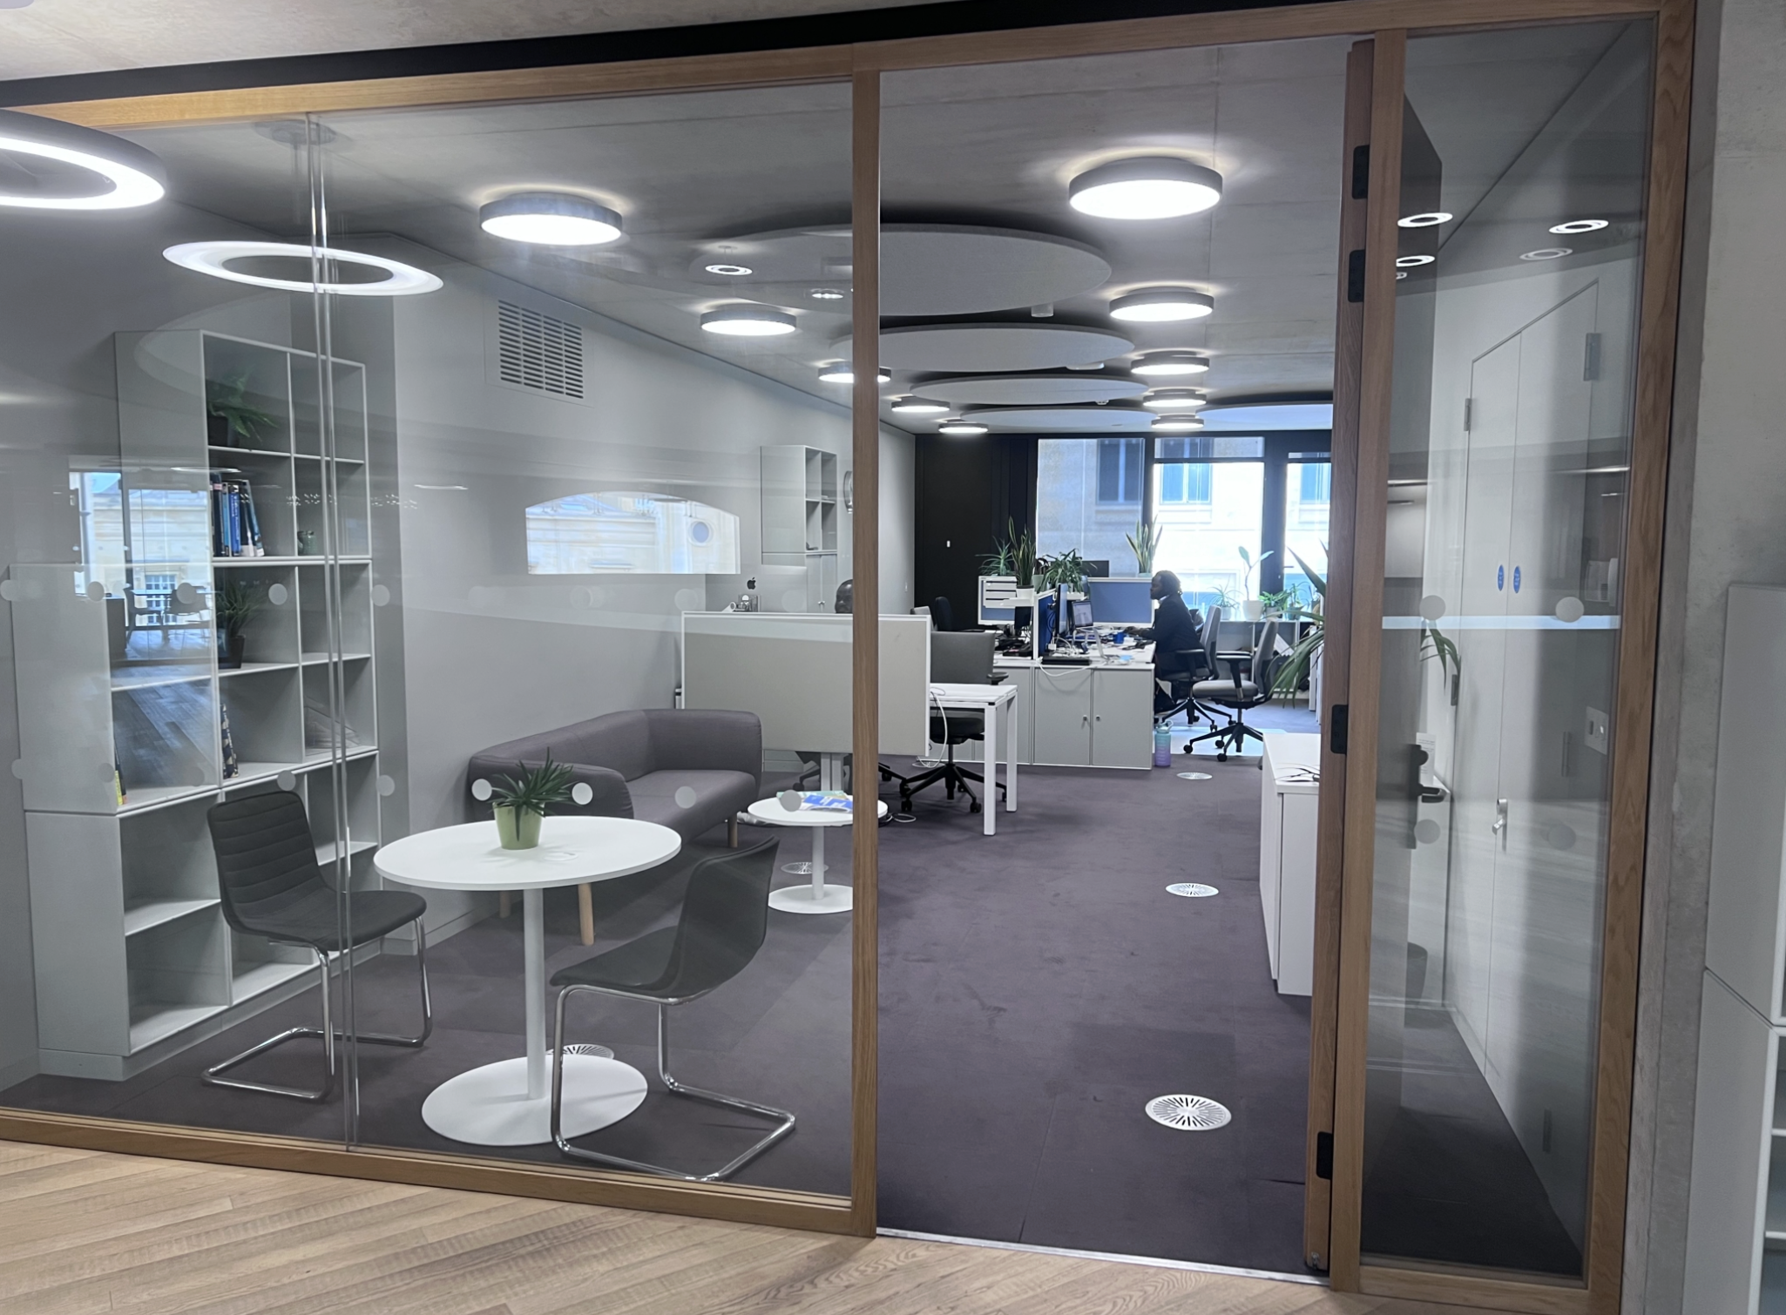
Welcome to the Blavatnik
IT & Digital Essentials
Presenter: Adham Tamer
Support website: https://support.bsg.ox.ac.uk
01865 614364
Level 1, Room 1.4
8:00-18:00
Notes:
Quick hello and purpose: accounts, Wi‑Fi, email, printing, security, and help. Keep it practical; QR links at the end.

Slide 2
Who we are & how to reach us
Email support: ict@bsg.ox.ac.uk
Phone support: (01865) 614364
IT Office: Level 1, Room 1.40
Opening hours: 08:00–18:00 (term & vacation)
IT & AV • ict@bsg.ox.ac.uk • (01865) 614364 • Level 1, Room 1.40 • 08:00–18:00
Notes:
Drop-ins welcome. Complex issues get ticketed so progress is tracked.

Slide 3
Accounts you’ll use at Oxford & BSG
Oxford SSO (abcd1234): Email, Canvas, Zoom, OneDrive, Teams, SharePoint
BSG Account: Printing (Follow‑Me / Mobility Print)
Remote Access: Wi‑Fi (eduroam) authentication
IT & AV • ict@bsg.ox.ac.uk • (01865) 614364 • Level 1, Room 1.40 • 08:00–18:00
Notes:
SSO is centrally managed; BSG account is departmental for printing. Remote Access is only for Wi‑Fi/eduroam.

Slide 4
Step 1: Activate SSO + set MFA
Go to webauth.ox.ac.uk → Activate a new account
Use your activation code (University Card pack/email)
Set a strong password & MFA (required)
Tip: Access Nexus365 at office.com using <yourSSO>@OX.AC.UK
IT & AV • ict@bsg.ox.ac.uk • (01865) 614364 • Level 1, Room 1.40 • 08:00–18:00
Notes:
Pattern is abcd1234; keep backup MFA method available.

Slide 5
Nexus365 email + apps you’ll actually use
Sign in via office.com using <yourSSO>@OX.AC.UK
Apps: Outlook, OneDrive, Teams, Word, Excel, PowerPoint, SharePoint
Mobile: Install Outlook app for best reliability
IT & AV • ict@bsg.ox.ac.uk • (01865) 614364 • Level 1, Room 1.40 • 08:00–18:00
Notes:
Recommend Outlook on mobile for push delivery and calendar. OneDrive for personal storage; SharePoint for team docs.

Slide 6
Choose your ‘From’ address
Receive mail to: firstname.lastname@bsg.ox.ac.uk and firstname.lastname@college.ox.ac.uk
Pick preferred sending address: register.it.ox.ac.uk/self/nexus
IT & AV • ict@bsg.ox.ac.uk • (01865) 614364 • Level 1, Room 1.40 • 08:00–18:00
Notes:
Both aliases deliver to one mailbox; set a default to avoid confusion externally.

Slide 7
Step 2: Connect to eduroam (recommended)
Set Remote Access password: register.it.ox.ac.uk/self/remote_access
Run eduroam tool: https://cat.eduroam.org
Username: abcd1234@OX.AC.UK + your Remote Access password
Induction backup network: BSG‑Events (temporary)
Full instructions: https://help.it.ox.ac.uk/how-to-connect-to-eduroam
IT & AV • ict@bsg.ox.ac.uk • (01865) 614364 • Level 1, Room 1.40 • 08:00–18:00
Notes:
Works across departments/colleges and many universities globally. Common mistake: wrong username format.

Slide 8
Step 3: Print from anywhere → collect anywhere
Install Mobility Print (2‑step installer provided by BSG)
Printers appear as: BSG Print (bsg‑print) Mobility
Sign in with your BSG username & password
Release by tapping your University card at any MFD
IT & AV • ict@bsg.ox.ac.uk • (01865) 614364 • Level 1, Room 1.40 • 08:00–18:00
Notes:
Follow‑Me holds your job until you sign in at a device.

Slide 9
Keep your work safe
Use long, unique passwords (≥16 where possible)
Never share passwords
Enable MFA and keep a backup method
Keep devices patched; run anti‑virus (Sophos available)
Be cautious on public Wi‑Fi/shared PCs
IT & AV • ict@bsg.ox.ac.uk • (01865) 614364 • Level 1, Room 1.40 • 08:00–18:00
Notes:
If a password is exposed, change immediately (SSO via self‑registration; BSG via account.bsg.ox.ac.uk).

Slide 10
Don’t lose your files: back it up
Use OneDrive for cloud sync of active work
Staff & graduate students can use CrashPlan backup service
See: https://help.it.ox.ac.uk/hfs-crashplan-cloud-backup-service
Keep an extra offline copy of key drafts/datasets
IT & AV • ict@bsg.ox.ac.uk • (01865) 614364 • Level 1, Room 1.40 • 08:00–18:00
Notes:
DPhils are graduate students—CrashPlan is appropriate. OneDrive has versioning to roll back.

Slide 11
Fix it fast — common gotchas
Can’t sign in to office.com? Use <SSO>@OX.AC.UK (not your email alias)
eduroam won’t connect? Check Remote Access password and rerun CAT
Print job missing? It’s queued—tap your card at the MFD you’re at
Forgot BSG password? https://account.bsg.ox.ac.uk/#/SelfPasswordReset
IT & AV • ict@bsg.ox.ac.uk • (01865) 614364 • Level 1, Room 1.40 • 08:00–18:00
Notes:
Top three issues: wrong username format, no Remote Access password, job not released at device.

Slide 12
Need help?
Email: ict@bsg.ox.ac.uk
https://support.bsg.ox.ac.uk
Phone: (01865) 614364
Visit: Level 1, Room 1.40 (08:00–18:00)
IT & AV • ict@bsg.ox.ac.uk • (01865) 614364 • Level 1, Room 1.40 • 08:00–18:00
Notes:
For urgent issues during teaching, phone is fastest; otherwise email for tracked support.

